Slide 1
Employee Data Analysis using Excel
STUDENT NAME: YAMUNA.R
REGISTER NO: 122202416 ECC4B5EB4A5ED0BBADF45A71DC
DEPARTMENT: CORPORATE SECRETARYSHIP
COLLEGE: BHAKTAVATSALAM MEMORIAL COLLEGE FOR WOMEN

Slide 2
PROJECT TITLE
M
Employee Performance Analysis using Excel

Slide 3


AGENDA
Problem Statement
Project Overview
End Users
Our Solution and Proposition
Dataset Description
Modelling Approach
Results and Discussion
Conclusion
3/21/2024 Annual Review

Slide 4

PROBLEM STATEMENT
Notes:
LACK OF OBJECTIVE EVALUATION :
Current performance evaluation methods may be subjective , relying heavily on personal opinions and biases
DIFFICULTY IN IDENTIFYING DEVELOPMENT AREAS :
Without clear and actionable feedback , employees may struggle to identify their strengths and weaknesses
INEFFECTIVE TALENT MANAGEMENT :
This can lead to suboptimal talent management strategies and missed opportunities for growth

Slide 5

PROJECT OVERVIEW
.
Notes:
he primary objective of this project is to analyze employee performance data to identify trends, strengths, weaknesses, and areas for improvement. This analysis aims to enhance overall productivity and employee satisfaction.
Scope
Collect performance data from various sources (e.g., performance reviews, KPIs, feedback surveys).
Analyze data to identify patterns and correlations.
Develop actionable insights and recommendations for management.
Methodology
Data Collection: Gather quantitative and qualitative data from performance reviews, self-assessments, peer reviews, and manager evaluations.
Data Analysis: Utilize statistical methods and data visualization tools to analyze the data. Techniques may include:
Descriptive statistics
Correlation analysis
Regression analysis
Visualization: Create dashboards and visual reports to present findings clearly.

Slide 6

WHO ARE THE END USERS?
Notes:
HR Professionals: Oversee performance management and training needs.
Management and Executives: Make strategic decisions based on team performance.
Team Leaders and Supervisors: Monitor and provide feedback on employee performance.
Employees: Seek feedback and understand their performance metrics.
Data Analysts: Conduct analysis and interpret performance data.
Organizational Development Specialists: Design training programs and initiatives.
External Consultants: Provide objective analysis and benchmarking.

Slide 7

OUR SOLUTION AND ITS VALUE PROPOSITION
Notes:
Solution: Implement a comprehensive performance analysis system that integrates data collection, statistical analysis, and visualization tools to assess employee performance effectively.
Value Proposition:
Data-Driven Insights: Provides actionable insights to enhance employee productivity and engagement.
Personalized Development: Identifies training needs and growth opportunities for employees.
Informed Decision-Making: Empowers management with data to make strategic HR decisions.
Improved Retention: Enhances employee satisfaction and retention through targeted interventions.

Slide 8
Dataset Description
Notes:
Employee ID: Unique identifier for each employee.
Name: Full name of the employee.
Department: Department where the employee works.
Performance Ratings: Scores from performance reviews (e.g., 1-5 scale).
KPI Metrics: Key performance indicators relevant to the role.
Feedback Comments: Qualitative feedback from managers and peers.
Training Records: History of training programs attended by the employee.

Slide 9

THE "WOW" IN OUR SOLUTION
3/21/2024 Annual Review
9

Slide 10
MODELLING
10
Notes:
Data Preprocessing: Clean and prepare the dataset for analysis (handling missing values, normalization).
Feature Selection: Identify relevant features that impact employee performance (e.g., KPIs, feedback).
Exploratory Data Analysis (EDA): Visualize data to uncover patterns and relationships.
Model Selection: Choose appropriate models (e.g., regression, decision trees, or machine learning algorithms).
Training the Model: Split the dataset into training and testing sets; train the model on the training set.
Model Evaluation: Assess model performance using metrics like accuracy, precision, and recall.
Hyperparameter Tuning: Optimize model parameters for better performance.
Validation: Validate the model using cross-validation techniques.
Deployment: Implement the model in a production environment for ongoing performance analysis.

Slide 11
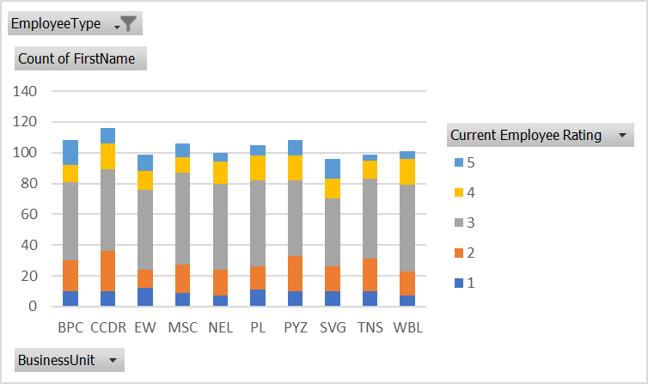
RESULTS
11

Slide 12
conclusion
Notes:
The Employee Performance Analysis project provides valuable insights into employee productivity and engagement. By leveraging data-driven methodologies, organizations can identify high performers, address skill gaps, and implement targeted development programs. This analysis not only enhances individual and team performance but also supports strategic decision-making, ultimately leading to improved employee satisfaction and retention. Embracing this analytical approach fosters a culture of continuous improvement and aligns workforce capabilities with organizational goals.

